Slide 1

CMSC 137
Data Communications and Networking
Lecture Module
14 – HDLC and PPP

Slide 2
Module 14: HDLC and PPP
Rozano S. Maniaol
Lecturer

Slide 3
High-level Data Link Control

Slide 4
High-level Data Link Control (HDLC)
A bit-oriented protocol for communication over point-to-point and multiple links
Implements the ARQ mechanisms discussed

Slide 5
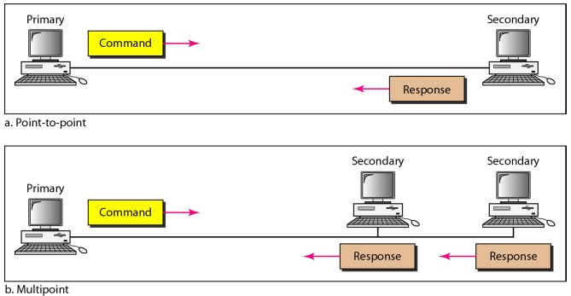
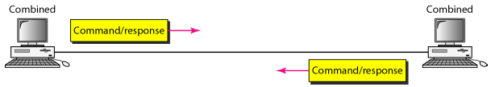
Transfer Modes
Normal Response Mode (NRM) – One primary stations and multiple secondary stations
Asynchronous Balanced Mode (ABM) – each station can function as primary and secondary

Slide 6
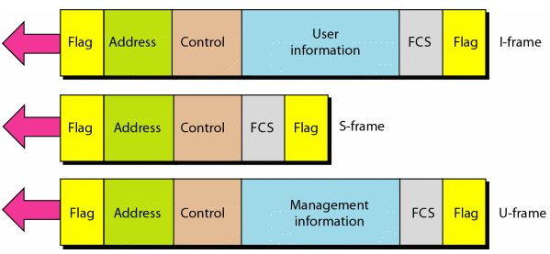
Frames
Information frames (I-frames) – used to data-link user data
Supervisory frames (S-frames) - used to transport control information
Unnumbered frames (U-frames) – reserved for system management

Slide 7
Frame Fields
Flag – 8-bit pattern: 01111110
Address – to secondary from primary; from secondary to primary;
  can be 1 byte or several bytes
  1 byte can identify up to 128 stations
  The last bit of the last byte is always ends with 1; signals the last byte of the address field
Control field – 1- or 2-byte segment used for flow and error control; depends on the type of frame
Information field – data
Frame Check Sequence – 2- or 4-byte ITU-T CRC

Slide 8
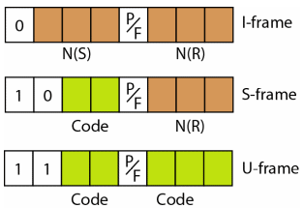
Control Field

Slide 9
Control Field: I-Frames
First bit: 0
N(S) – sequence number of the frame
N(R) – acknowledgment number when piggybacking is used
P/F bit – Poll or Final bit

Slide 10
Control Field: S-Frames
First two bits: 10
Control Codes
  Receive ready (RR) - 00
  Receive not ready (RNR) – 10 ; receiver is busy
  Reject (REJ) – 01; NAK used in GBN
  Selective reject (SREJ) – 11; NAK used in SR

Slide 11
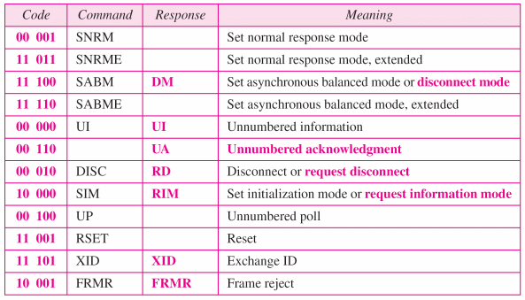
Control Field: U-Frames
First two bits: 11

Slide 12
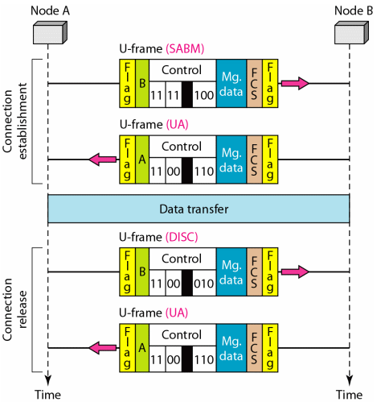
Connection and Disconnection

Slide 13
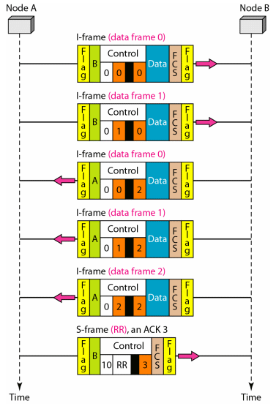
Piggybacking without error

Slide 14
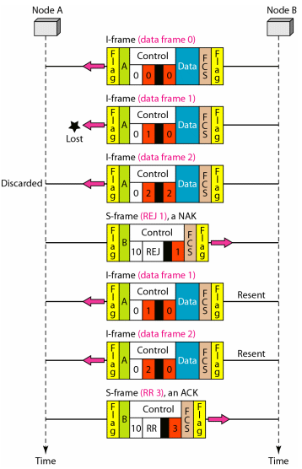
Piggybacking with error

Slide 15
Point-to-Point Protocol

Slide 16
Point-to-Point Protocol (PPP)
Used in home computers connecting to ISPs
Traditional modem connection through a telephone line
Most common data link layer protocol
Byte-oriented protocol

Slide 17
PPP Services
Defines the format of the frame
Defines how two devices negotiate link establishment
Defines how network layer data are encapsulated in the data link frame
Defines how two devices authenticate each other
Provides connections over multiple links
Provides network address configuration

Slide 18
PPP Missing Services
Does not provide flow control
Very simple mechanism for error control using CRC
Does not provide sophisticated addressing mechanism to handle frames in a multipoint configuration

Slide 19

PPP Frame
Flag – 01111110; treated as a byte
Address – 11111111 (broadcast address)
Control – 00000011 (imitating unnumbered frames in HDLC)
Protocol – defines what is being carried in payload
Payload – user data or control information
Frame Check Sequence – 2-byte or 4-byte standard CRC
ESC byte for stuffing: 01111101

Slide 20
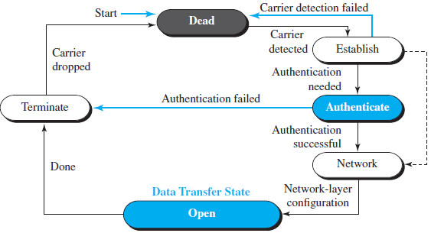
PPP Transition Phases

Slide 21
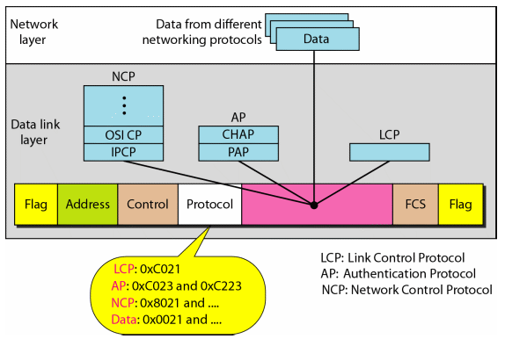
Multiplexing in PPP

Slide 22
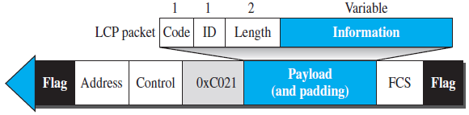
Link Control Protocol (LCP)
Responsible for establishing, maintaining, configuring and terminating links
Provides negotiation mechanisms to set options between the two endpoints

Slide 23
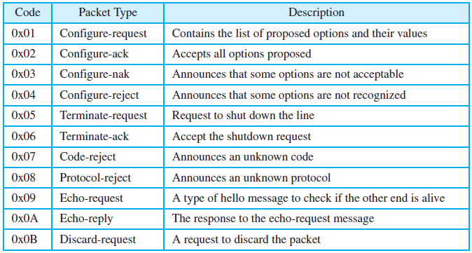
Link Control Protocol (LCP)

Slide 24
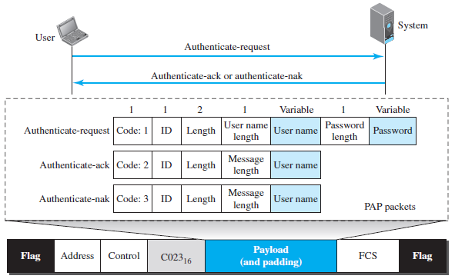
Authentication Protocols
Password Authentication Protocol (PAP)

Slide 25
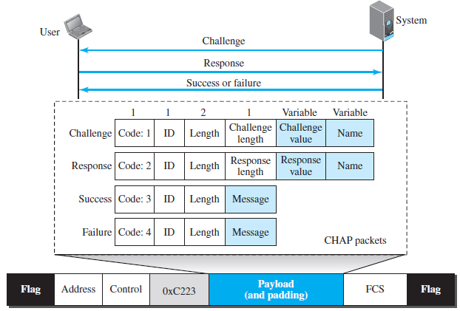
Authentication Protocols
Challenge Handshake Authentication Protocol (CHAP)

Slide 26
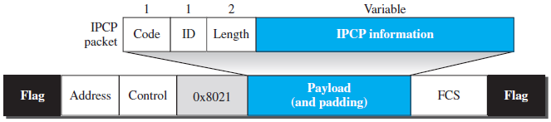
Network Control Protocols
PPP carry a network layer data packet from protocols defined by the Internet
Internet Protocol Control Protocol (IPCP) – configures the link used to carry IP packets

Slide 27
References
Forouzan, B.A. 2013. Data Communications and Networking, 5th Ed. McGraw-Hill, New York.

